Slide 1


Slide 2
Chapter 12
Forecasting

Slide 3

OBJECTIVES
Demand Management
Qualitative Forecasting Methods
Simple & Weighted Moving Average Forecasts
Exponential Smoothing
Simple Linear Regression
Web-Based Forecasting
Notes:
2

Slide 4
Demand Management
Independent Demand:
Finished Goods
A
Dependent Demand:
Raw Materials,
Component parts,
Sub-assemblies, etc.
B(4)
C(2)
D(2)
E(1)
D(3)
F(2)
Notes:
3

Slide 5
Independent Demand:
What a firm can do to manage it?
Can take an active role to influence demand
Can take a passive role and simply respond to demand
Notes:
4

Slide 6
Types of Forecasts
Qualitative (Judgmental)
Quantitative
  Time Series Analysis
  Causal Relationships
  Simulation
Notes:
5

Slide 7
Components of Demand
Average demand for a period of time
Trend
Seasonal element
Cyclical elements
Random variation
Autocorrelation
Notes:
7

Slide 8
Finding Components of Demand
Seasonal variation
x
x
Linear
Trend
x
x
x
x
x
x
x
Sales
x
x
x
x
x
x
x
x
x
x
x
x
x
x
x
x
x
x
x
x
x
x
x
x
x
x
x
x
x
x
x
x
x
x
x
x
x
x
1
2
3
4
Year
Notes:
6

Slide 9
Qualitative Methods
Executive Judgment
Grass Roots
Qualitative
Methods
Market Research
Historical analogy
Delphi Method
Panel Consensus

Slide 10
Delphi Method
l. Choose the experts to participate representing a variety of knowledgeable people in different areas
2. Through a questionnaire (or E-mail), obtain forecasts (and any premises or qualifications for the forecasts) from all participants
3. Summarize the results and redistribute them to the participants along with appropriate new questions
4. Summarize again, refining forecasts and conditions, and again develop new questions
5. Repeat Step 4 as necessary and distribute the final results to all participants
Notes:
10

Slide 11
Time Series Analysis
Time series forecasting models try to predict the future based on past data
You can pick models based on:
1. Time horizon to forecast
2. Data availability
3. Accuracy required
4. Size of forecasting budget
5. Availability of qualified personnel
Notes:
14

Slide 12
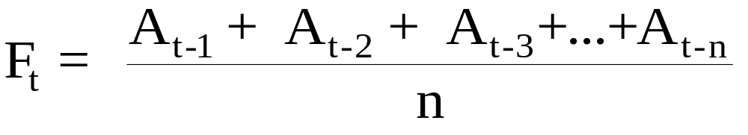
Simple Moving Average Formula
The simple moving average model assumes an average is a good estimator of future behavior
The formula for the simple moving average is:
F_{t} = Forecast for the coming period
N = Number of periods to be averaged
A _{t-1} = Actual occurrence in the past period for up to “n” periods
Notes:
15

Slide 13
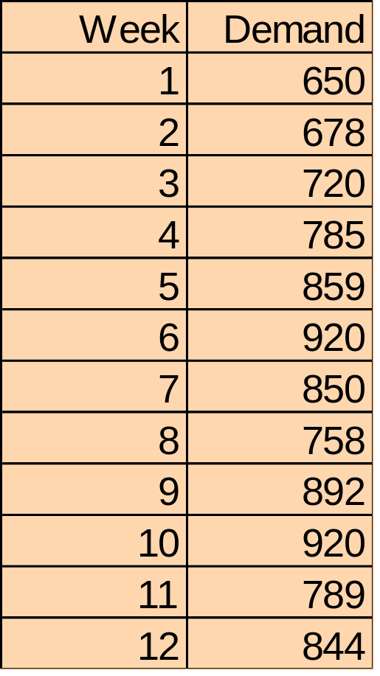
Simple Moving Average Problem (1)
Question: What are the 3-week and 6-week moving average forecasts for demand?
Assume you only have 3 weeks and 6 weeks of actual demand data for the respective forecasts
Notes:
15

Slide 14
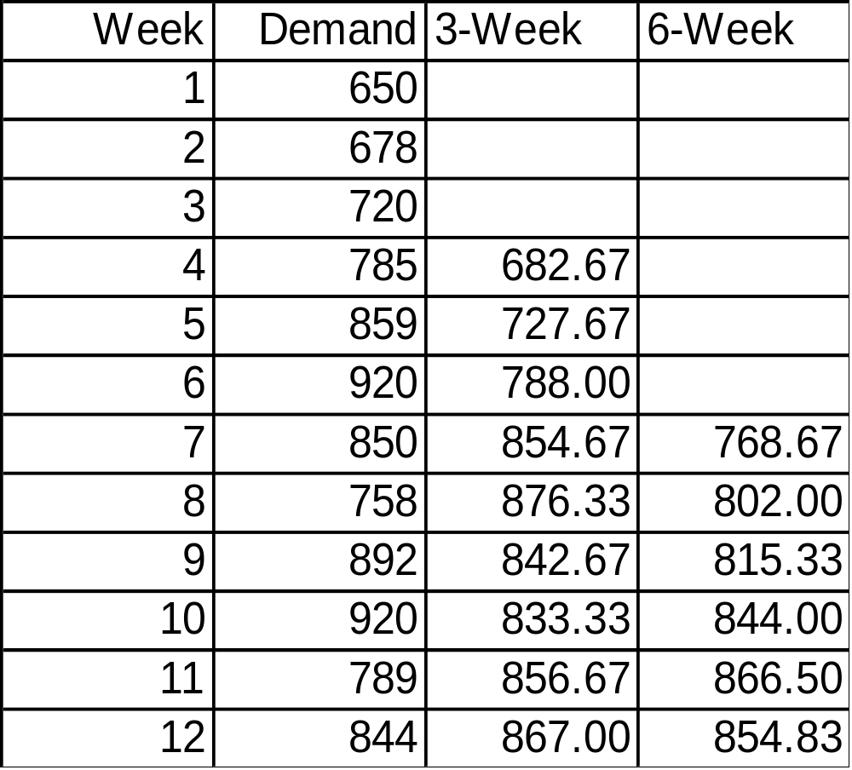
Calculating the moving averages gives us:
F₄=(650+678+720)/3
=682.67
F₇=(650+678+720
+785+859+920)/6
=768.67
The McGraw-Hill Companies, Inc., 2004
Notes:
16

Slide 15
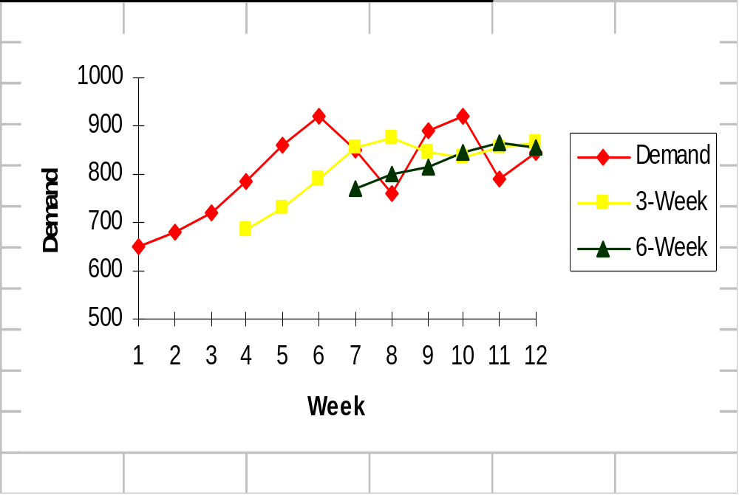
Plotting the moving averages and comparing them shows how the lines smooth out to reveal the overall upward trend in this example
Note how the 3-Week is smoother than the Demand, and 6-Week is even smoother
Notes:
17

Slide 16
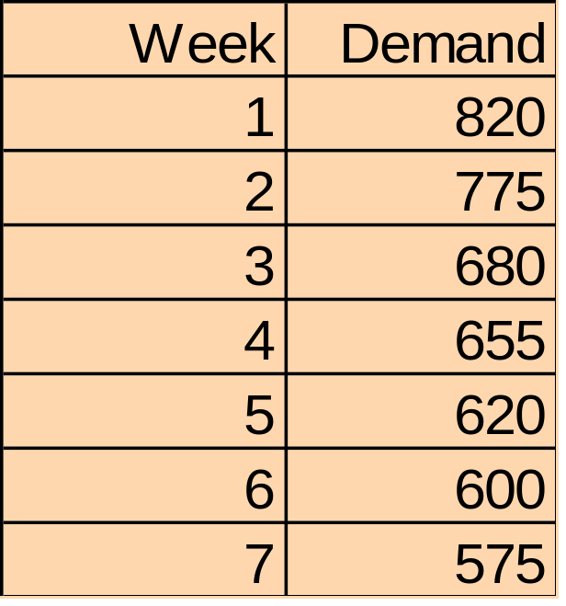
Simple Moving Average Problem (2) Data
Question: What is the 3 week moving average forecast for this data?
Assume you only have 3 weeks and 5 weeks of actual demand data for the respective forecasts
Notes:
18

Slide 17
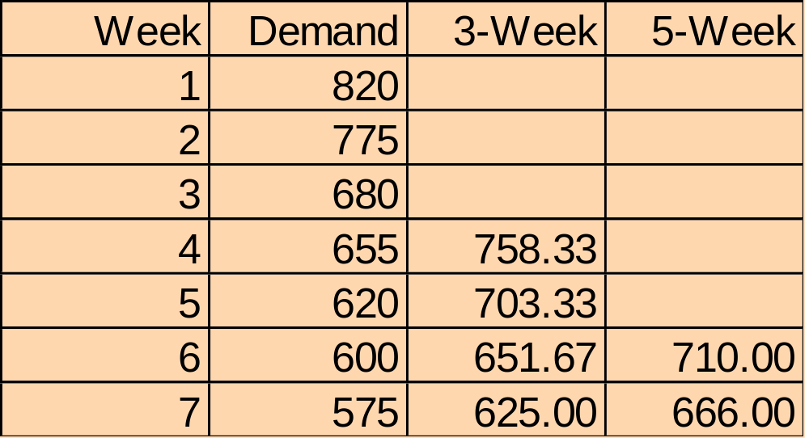
Simple Moving Average Problem (2) Solution
F₄=(820+775+680)/3
=758.33
F₆=(820+775+680
+655+620)/5
=710.00
Notes:
19

Slide 18
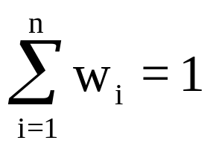
Weighted Moving Average Formula
While the moving average formula implies an equal weight being placed on each value that is being averaged, the weighted moving average permits an unequal weighting on prior time periods
The formula for the moving average is:
w_{t} = weight given to time period “t” occurrence (weights must add to one)
Notes:
20

Slide 19
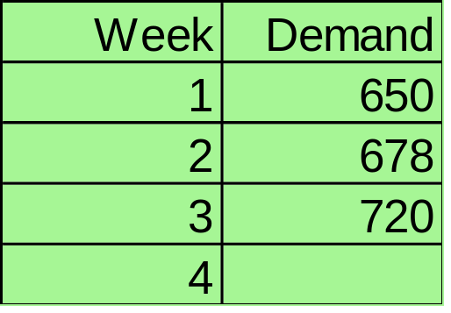
Weighted Moving Average Problem (1) Data
Question: Given the weekly demand and weights, what is the forecast for the 4th period or Week 4?
Weights:
t-1 .5
t-2 .3
t-3 .2
Note that the weights place more emphasis on the most recent data, that is time period “t-1”
Notes:
20

Slide 20
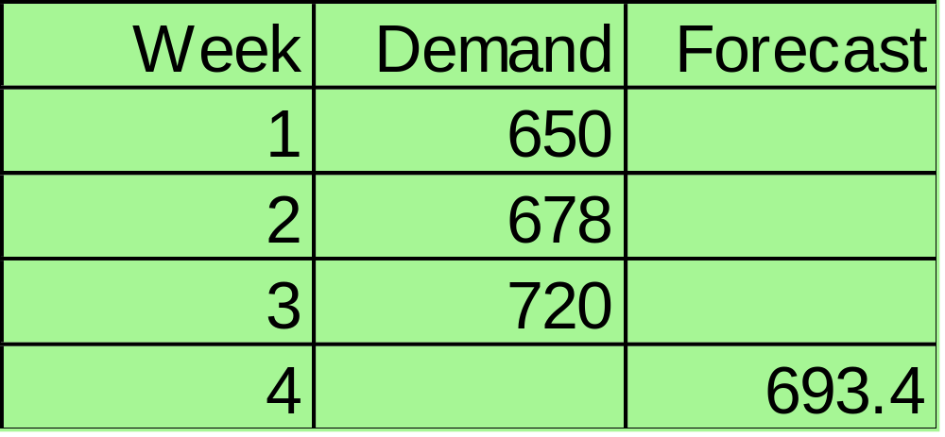
Weighted Moving Average Problem (1) Solution
F₄ = 0.5(720)+0.3(678)+0.2(650)=693.4
Notes:
21

Slide 21
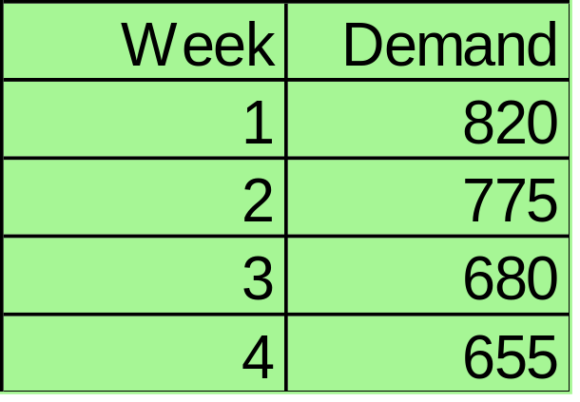
Weighted Moving Average Problem (2) Data
Question: Given the weekly demand information and weights, what is the weighted moving average forecast of the 5th period or week?
Weights:
t-1 .7
t-2 .2
t-3 .1
Notes:
22

Slide 22
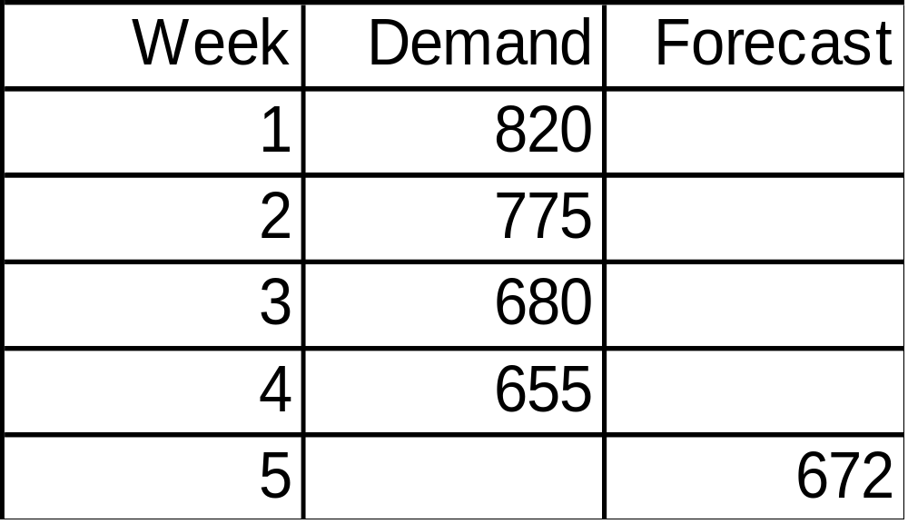
Weighted Moving Average Problem (2) Solution
F₅ = (0.1)(755)+(0.2)(680)+(0.7)(655)= 672
Notes:
23

Slide 23
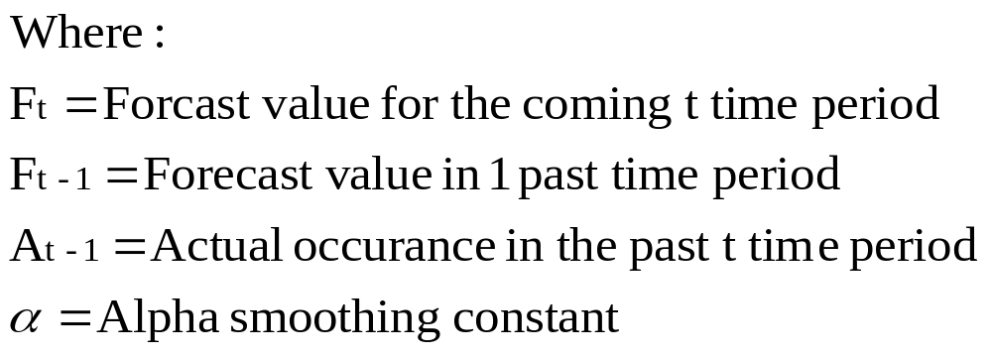
Exponential Smoothing Model
F_{t} = F_{t-1} + α(A_{t-1} - F_{t-1})
Premise: The most recent observations might have the highest predictive value
Therefore, we should give more weight to the more recent time periods when forecasting
Notes:
24

Slide 24
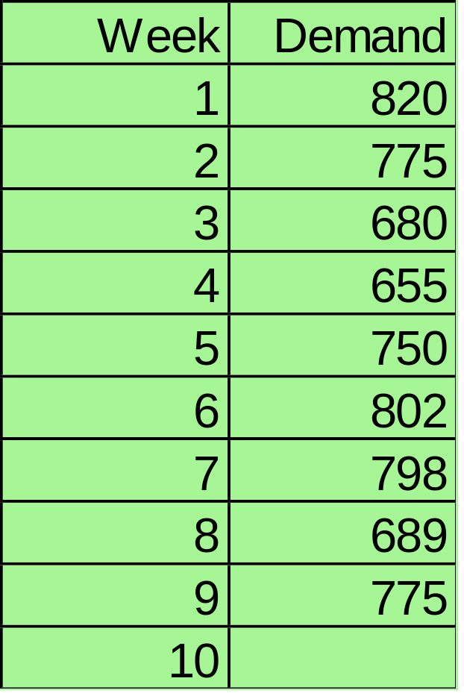
Exponential Smoothing Problem (1) Data
Question: Given the weekly demand data, what are the exponential smoothing forecasts for periods 2-10 using α=0.10 and α=0.60?
Assume F₁=D₁
Notes:
25

Slide 25
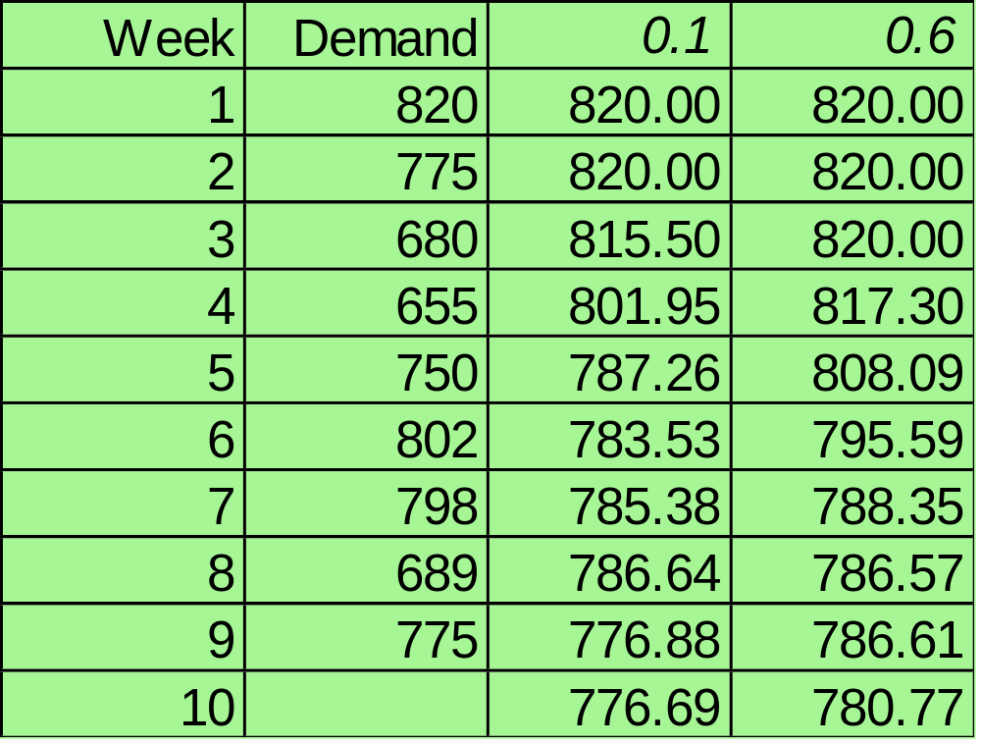
Answer: The respective alphas columns denote the forecast values. Note that you can only forecast one time period into the future.
Notes:
26

Slide 26
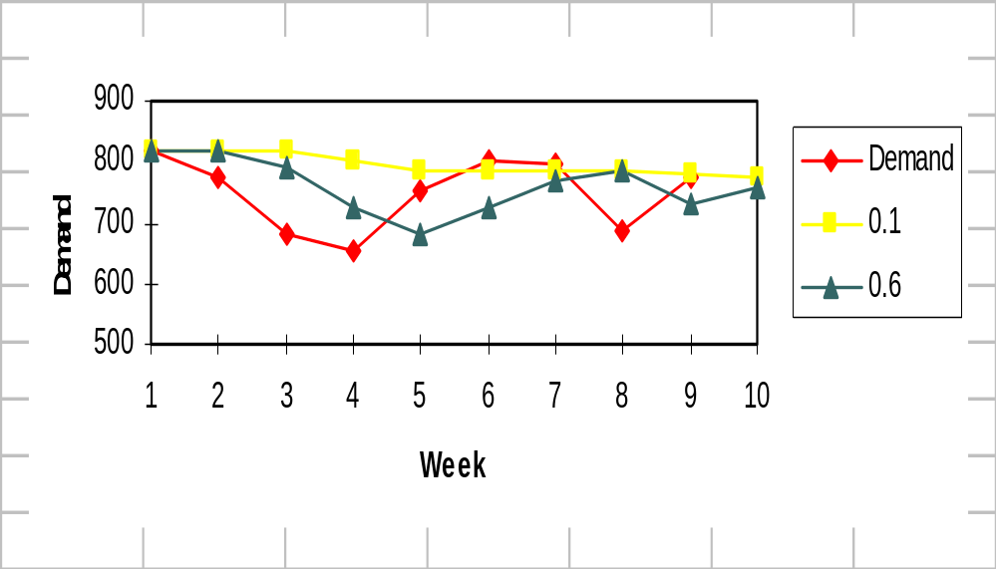
Exponential Smoothing Problem (1) Plotting
Note how that the smaller alpha results in a smoother line in this example
Notes:
27

Slide 27
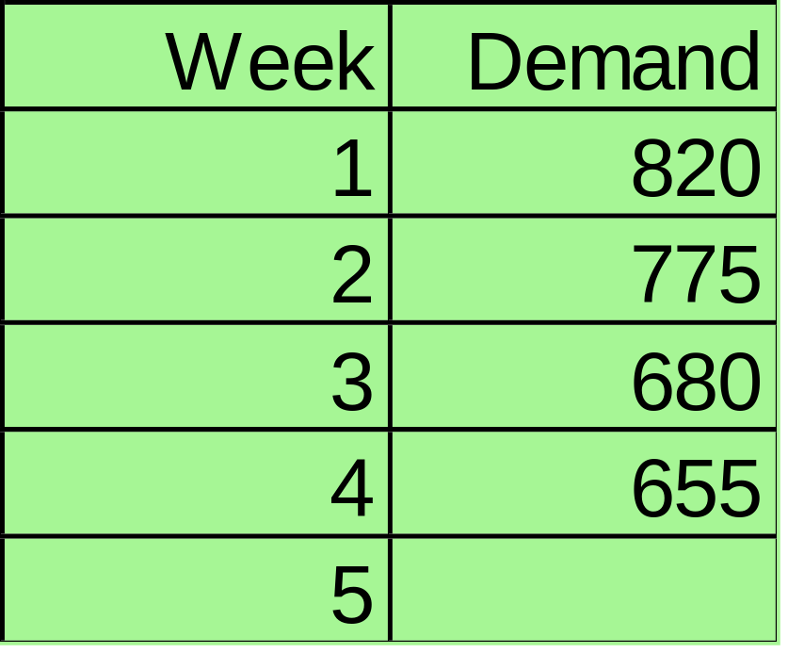
Exponential Smoothing Problem (2) Data
Question: What are the exponential smoothing forecasts for periods 2-5 using a =0.5?
Assume F₁=D₁
Notes:
28

Slide 28
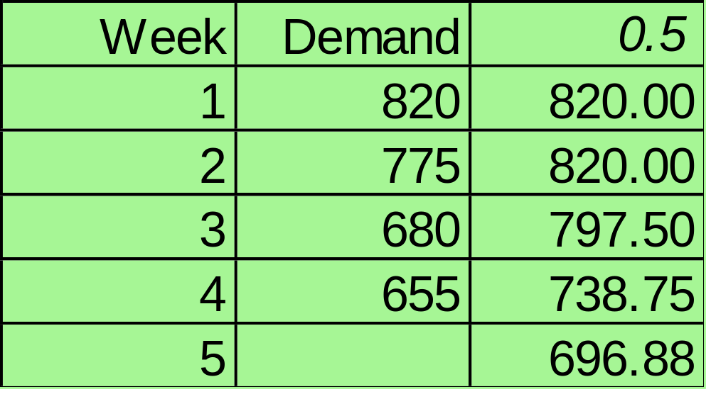
Exponential Smoothing Problem (2) Solution
F₁=820+(0.5)(820-820)=820
F₃=820+(0.5)(775-820)=797.75
Notes:
29

Slide 29
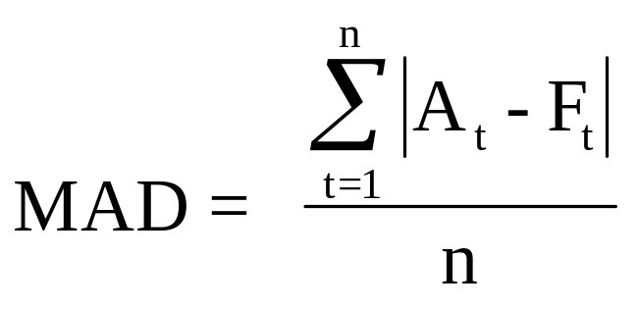
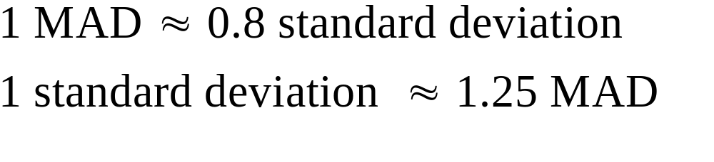
The MAD Statistic to Determine Forecasting Error
The ideal MAD is zero which would mean there is no forecasting error
The larger the MAD, the less the accurate the resulting model
Notes:
30

Slide 30
MAD Problem Data
Question: What is the MAD value given the forecast values in the table below?
Month
Sales
Forecast
1
220
n/a
2
250
255
3
210
205
4
300
320
5
325
315
Notes:
31

Slide 31
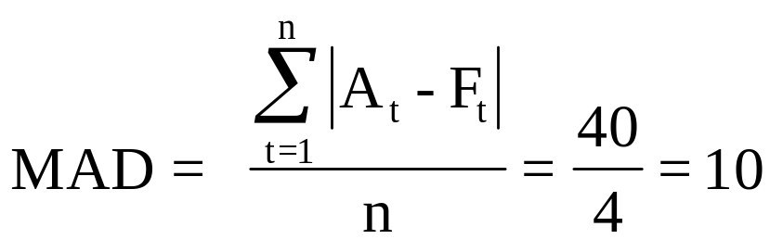
MAD Problem Solution
Month
Sales
Forecast
Abs Error
1
220
n/a
2
250
255
5
3
210
205
5
4
300
320
20
5
325
315
10
40
Note that by itself, the MAD only lets us know the mean error in a set of forecasts
Notes:
32

Slide 32
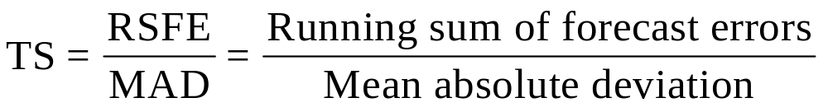
Tracking Signal Formula
The Tracking Signal or TS is a measure that indicates whether the forecast average is keeping pace with any genuine upward or downward changes in demand.
Depending on the number of MAD’s selected, the TS can be used like a quality control chart indicating when the model is generating too much error in its forecasts.
The TS formula is:
Notes:
33

Slide 33
Simple Linear Regression Model
The simple linear regression model seeks to fit a line through various data over time
Y
a
0 1 2 3 4 5 x (Time)
Y_{t} = a + bx
Is the linear regression model
Yt is the regressed forecast value or dependent variable in the model, a is the intercept value of the the regression line, and b is similar to the slope of the regression line. However, since it is calculated with the variability of the data in mind, its formulation is not as straight forward as our usual notion of slope.
Notes:
35

Slide 34
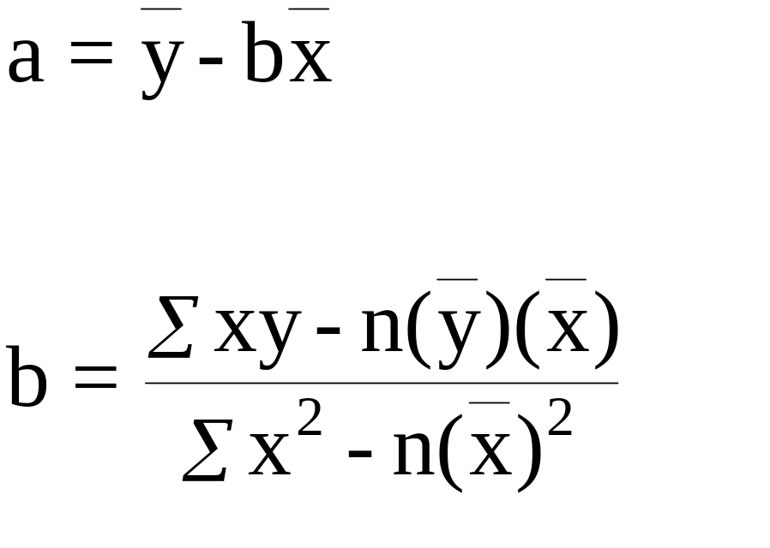
Simple Linear Regression Formulas for Calculating “a” and “b”
Notes:
36

Slide 35
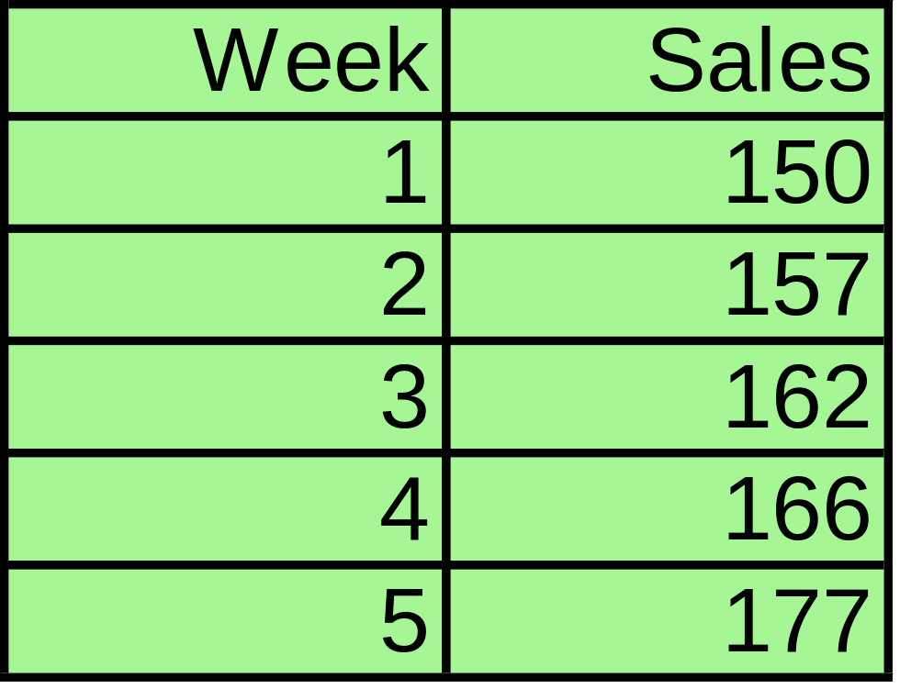
Simple Linear Regression Problem Data
Question: Given the data below, what is the simple linear regression model that can be used to predict sales in future weeks?
Notes:
37

Slide 36
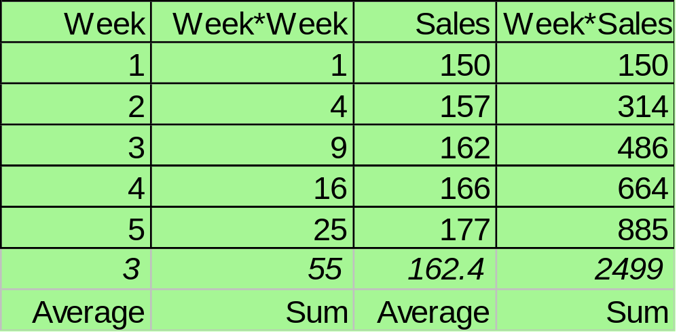
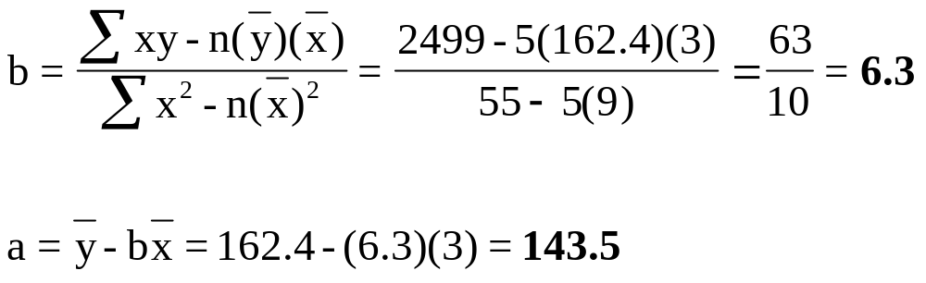
Answer: First, using the linear regression formulas, we can compute “a” and “b”
Notes:
38

Slide 37
The resulting regression model is:
Y_{t} = 143.5 + 6.3x
Now if we plot the regression generated forecasts against the actual sales we obtain the following chart:
180
175
170
165
160
Sales
Sales
155
Forecast
150
145
140
135
1
2
3
4
5
Period
Notes:
39

Slide 38
Web-Based Forecasting: CPFR
Defined
Collaborative Planning, Forecasting, and Replenishment (CPFR) a Web-based tool used to coordinate demand forecasting, production and purchase planning, and inventory replenishment between supply chain trading partners.
Used to integrate the multi-tier or n-Tier supply chain, including manufacturers, distributors and retailers.
CPFR’s objective is to exchange selected internal information to provide for a reliable, longer term future views of demand in the supply chain.
CPFR uses a cyclic and iterative approach to derive consensus forecasts.
Notes:
33

Slide 39
Web-Based Forecasting:
Steps in CPFR
1. Creation of a front-end partnership agreement
2. Joint business planning
3. Development of demand forecasts
4. Sharing forecasts
5. Inventory replenishment
Notes:
33

Slide 40
End of Chapter 12

